Slide 1
Chapter 3 figures

Slide 2
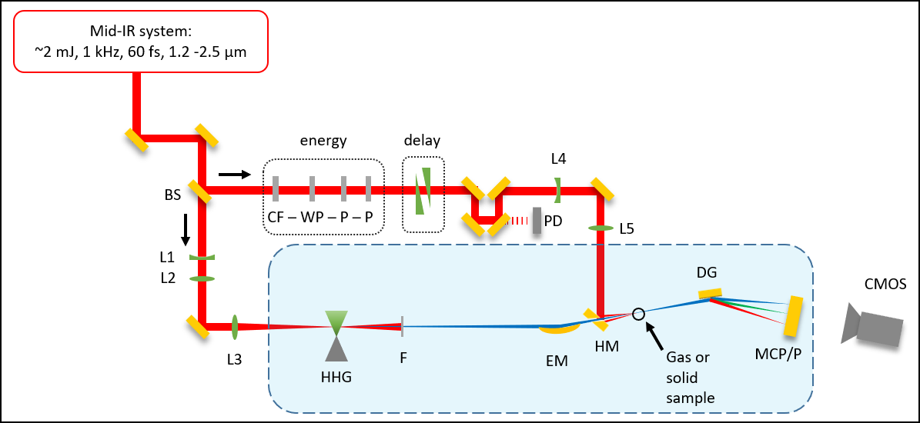
Beamline cartoon (image)
S
S

Slide 3



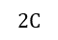
Beamline cartoon (editable)
Mid-IR system:
~2 mJ, 1 kHz, 60 fs, 1.2 -2.5 μm
energy
delay
S
L4
BS
CF – WP – P – P
W
PD
L5
S
L1
DG
L2
CMOS
I
L3
$$2C$$
F
EM
HM
SH
MCP/P
HHG

Slide 4
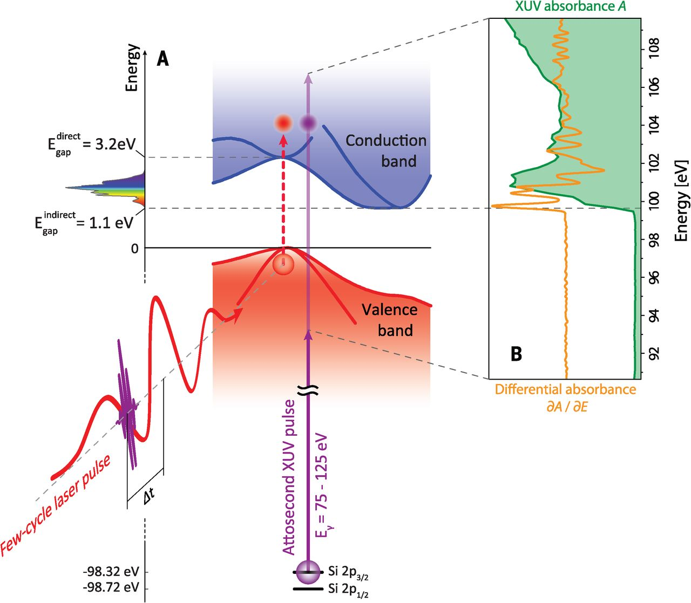

Slide 5
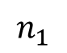
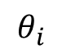
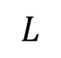
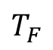
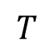
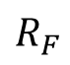
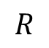
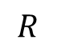
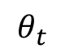
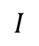
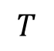
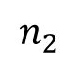
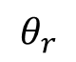
Fresnel geometry
a)
b)
$$L$$
$$I$$
interface
$$T$$
$$T_{F}$$
$$θ_{i}$$
normal
$$θ_{r}$$
$$θ_{t}$$
$$R$$
$$R$$
$$T$$
$$R_{F}$$
$$n_{1}$$
$$n_{2}$$

Slide 6
7.5 mm
3 mm
100 nm Ge
30 nm SiNx
500 μm Si
7.5 mm
3 mm
100 nm Ge
30 nm SiNx
500 μm Si
Notes:
Sample_Geometry.png

Slide 7
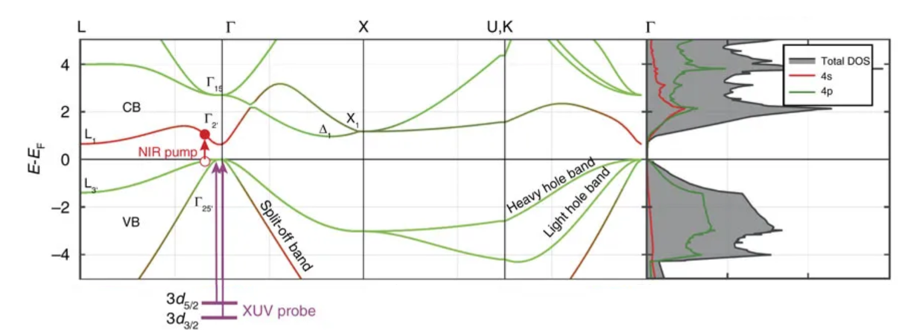

Slide 8
Knife edge cartoon
XUV
XUV detector

Slide 9
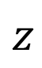
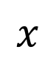
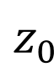
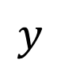
Knife edge cartoon
$$y$$
EM
$$z$$
$$x$$
XUV
XUV detector
$$z_{0}$$

Slide 10
Imaging the samples under vacuum
C
1 inch
FM
HM
SH
1 inch
L

Slide 11
Si, 260 nm
Si, one hole <200μm
“popped” 30 nm SiN

Slide 12
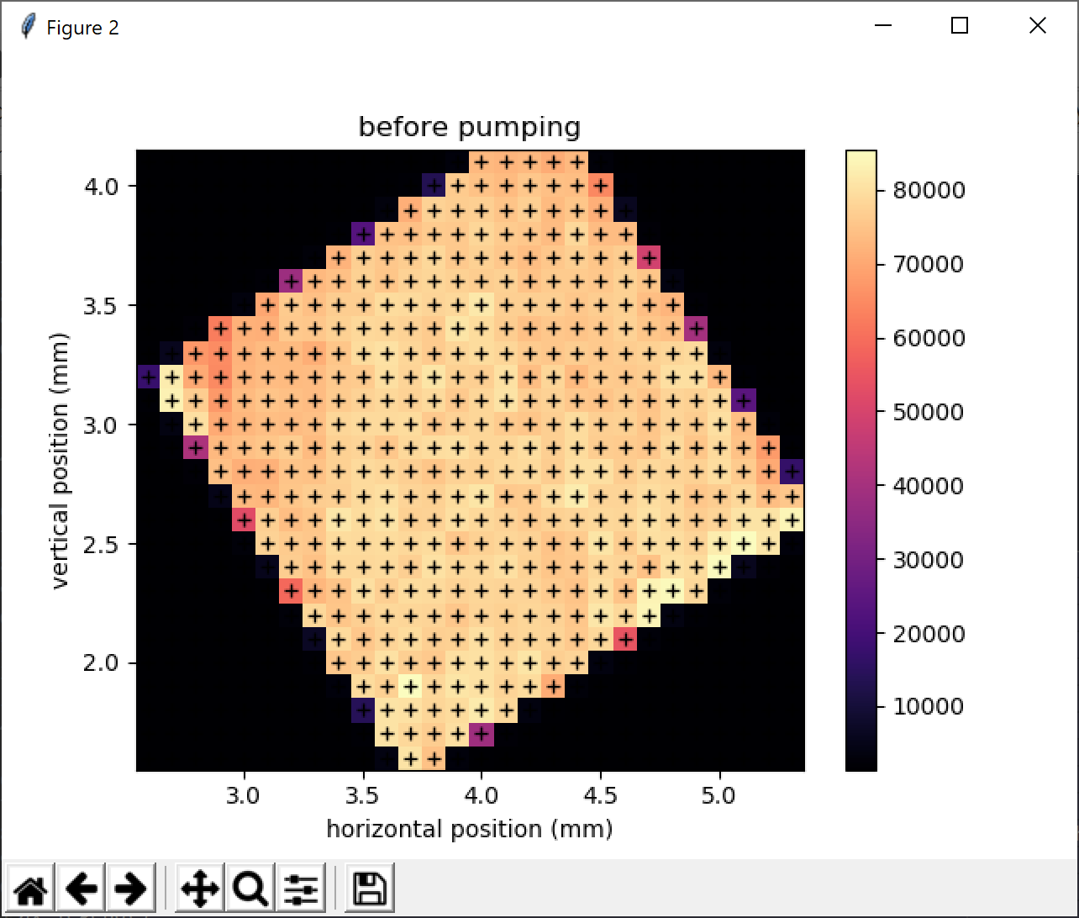
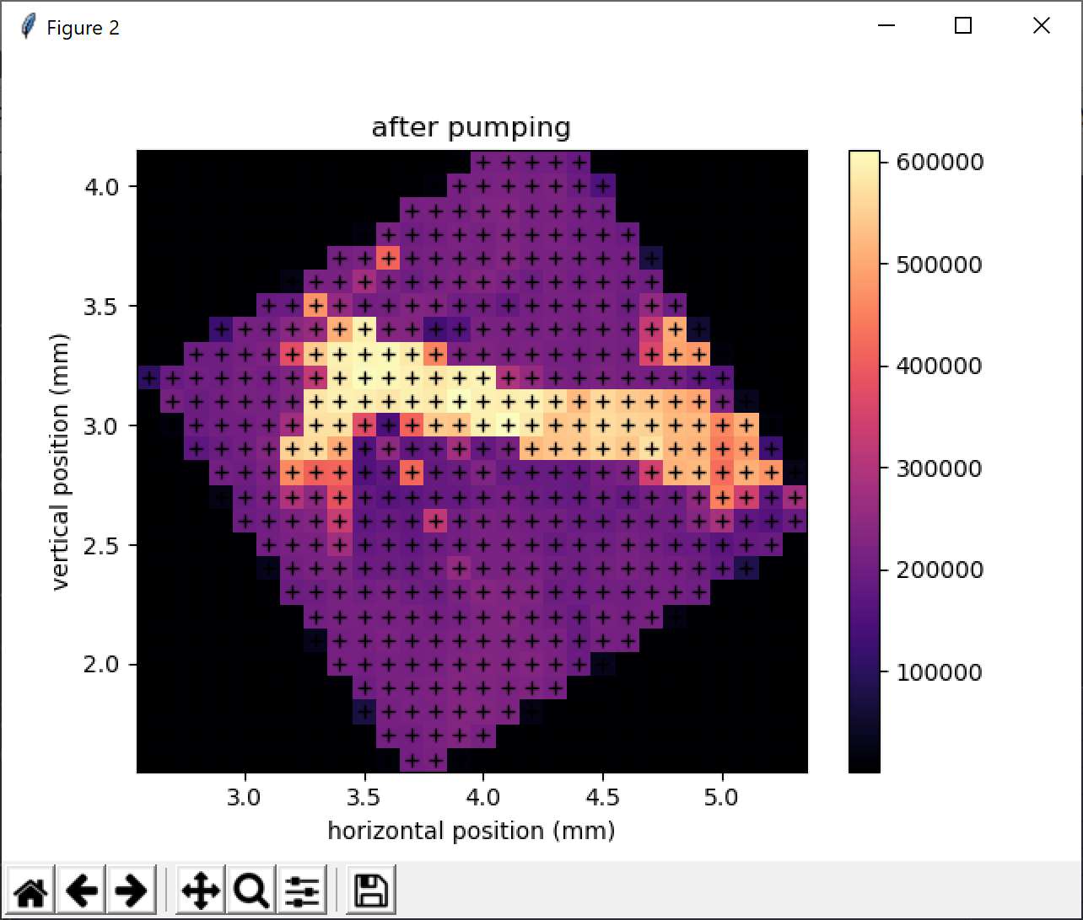
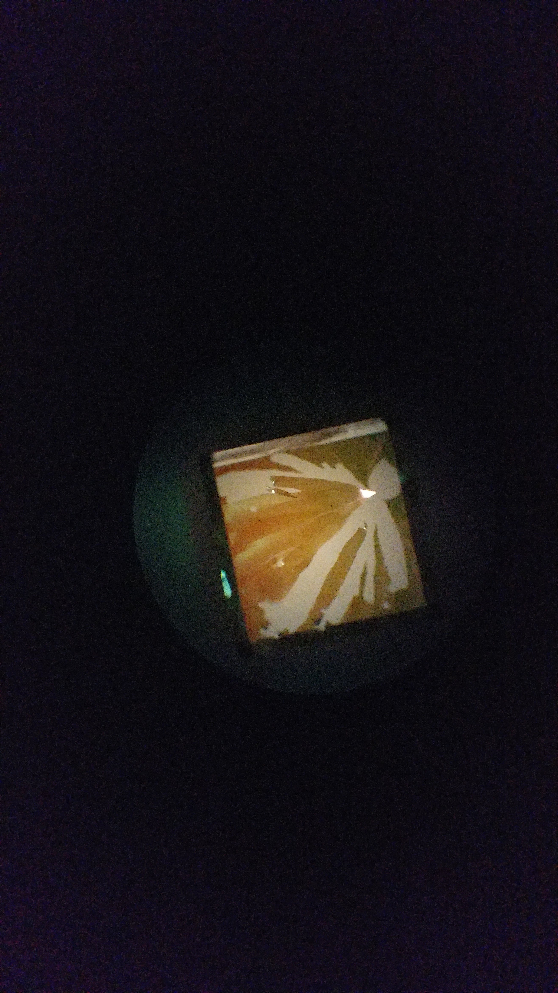
200 nm Si
200 nm Si
200 nm Si
IR-pumped areas
microscope image
Notes:
Figures from 2019-04-19 powerpoint presentation … “before pumping” was 4/09/2019 map1. “after pumping” was 4/10/2019 map1.

Slide 13
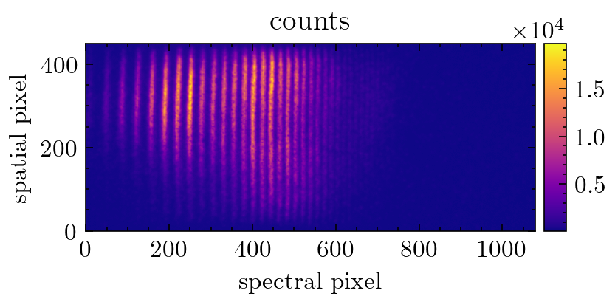
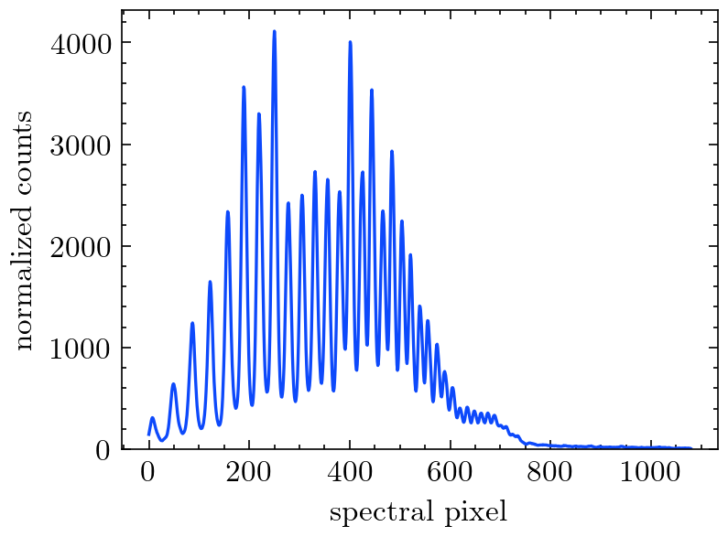
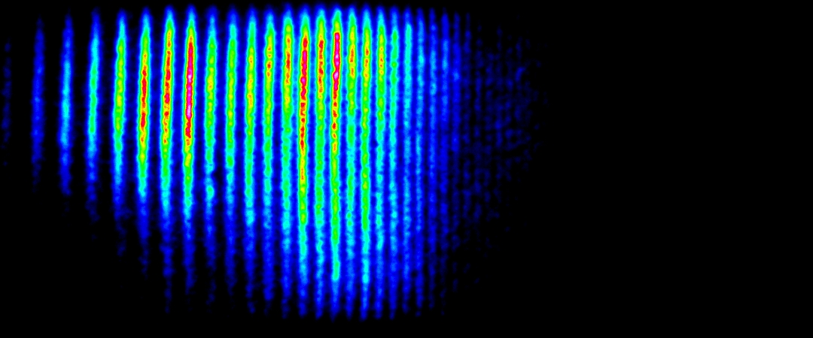
2D spectrometer image
Raw 2D image
Spectral lineout
Filtering
Delta-OD calculation
Delta-OD normalization
Average delta-OD
Energy calibration
Background subtraction, exposure time normalization, normalized spatial integration,

Slide 14
Finding temporal overlap in vacuum (or vented)
PA
FM
HM
SH
GA
L
C

Slide 15
Si, 260 nm
Si, one hole <200μm
“popped” 30 nm SiN
200 nm Si
200 nm Si
200 nm Si
IR-pumped areas
microscope image
Notes:
Figures from 2019-04-19 powerpoint presentation … “before pumping” was 4/09/2019 map1. “after pumping” was 4/10/2019 map1.

Slide 16
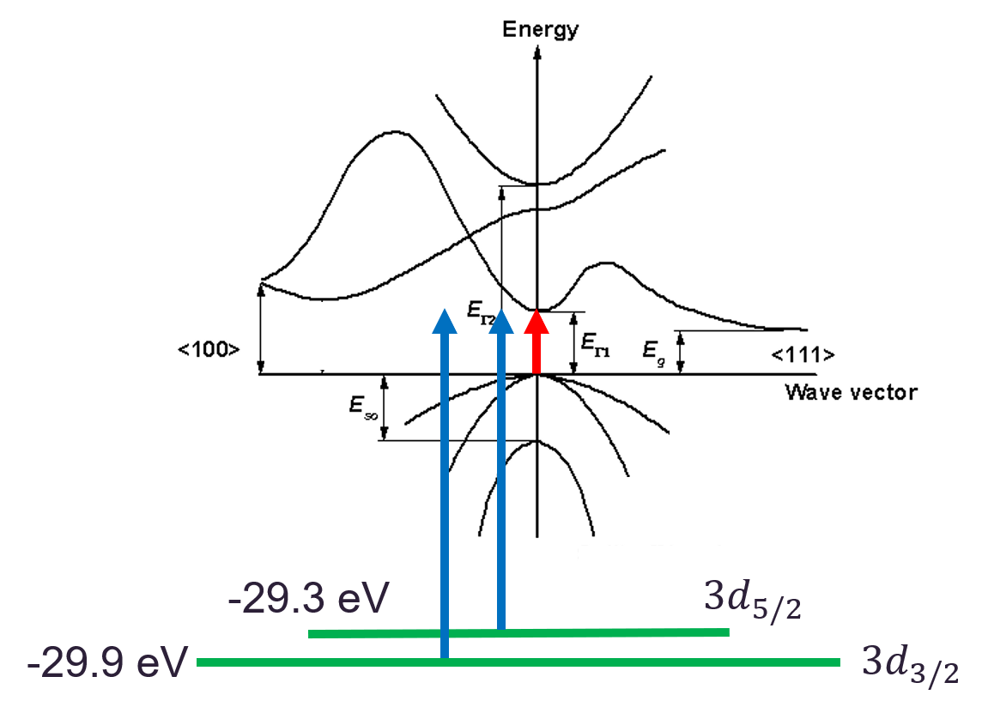

Slide 17
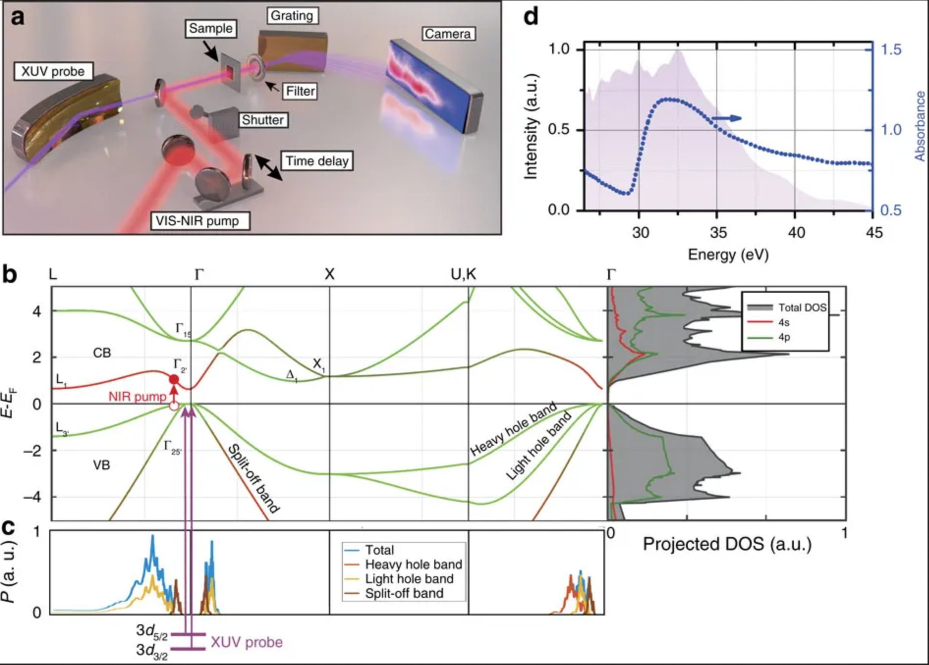
Germanium bandgap
M. Zürch, Nat. Commun. 8, no. 1, 15734 (2017)

Slide 18
Germanium bandgap
M. Zürch, Nat. Commun. 8, no. 1, 15734 (2017)

Slide 19
Germanium bandgap
M. Zürch, Nat. Commun. 8, no. 1, 15734 (2017)

Slide 20
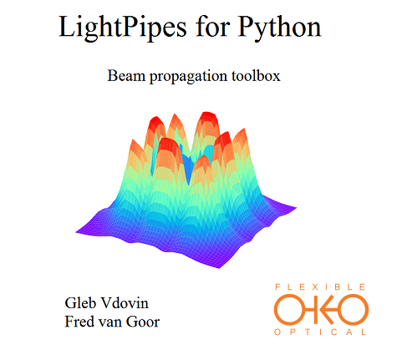
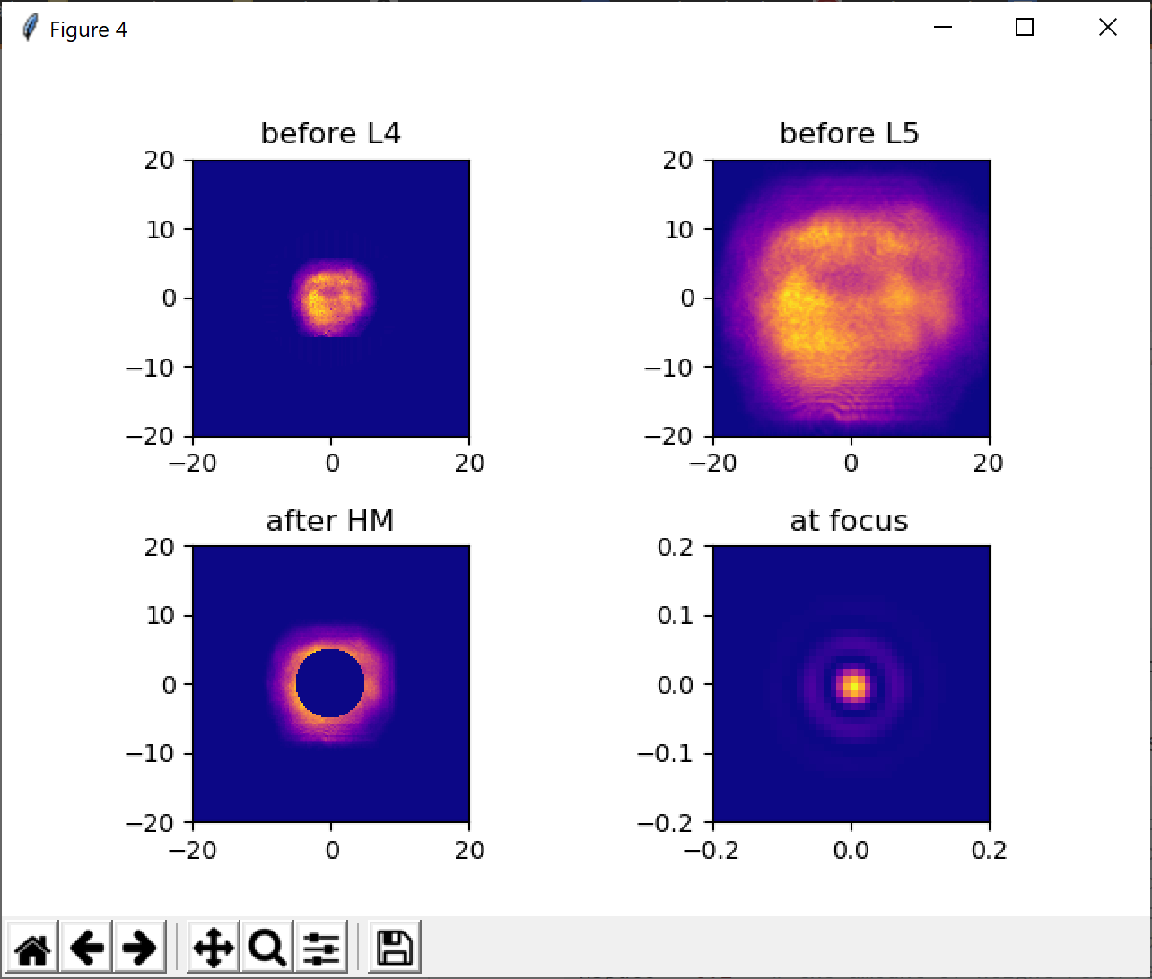
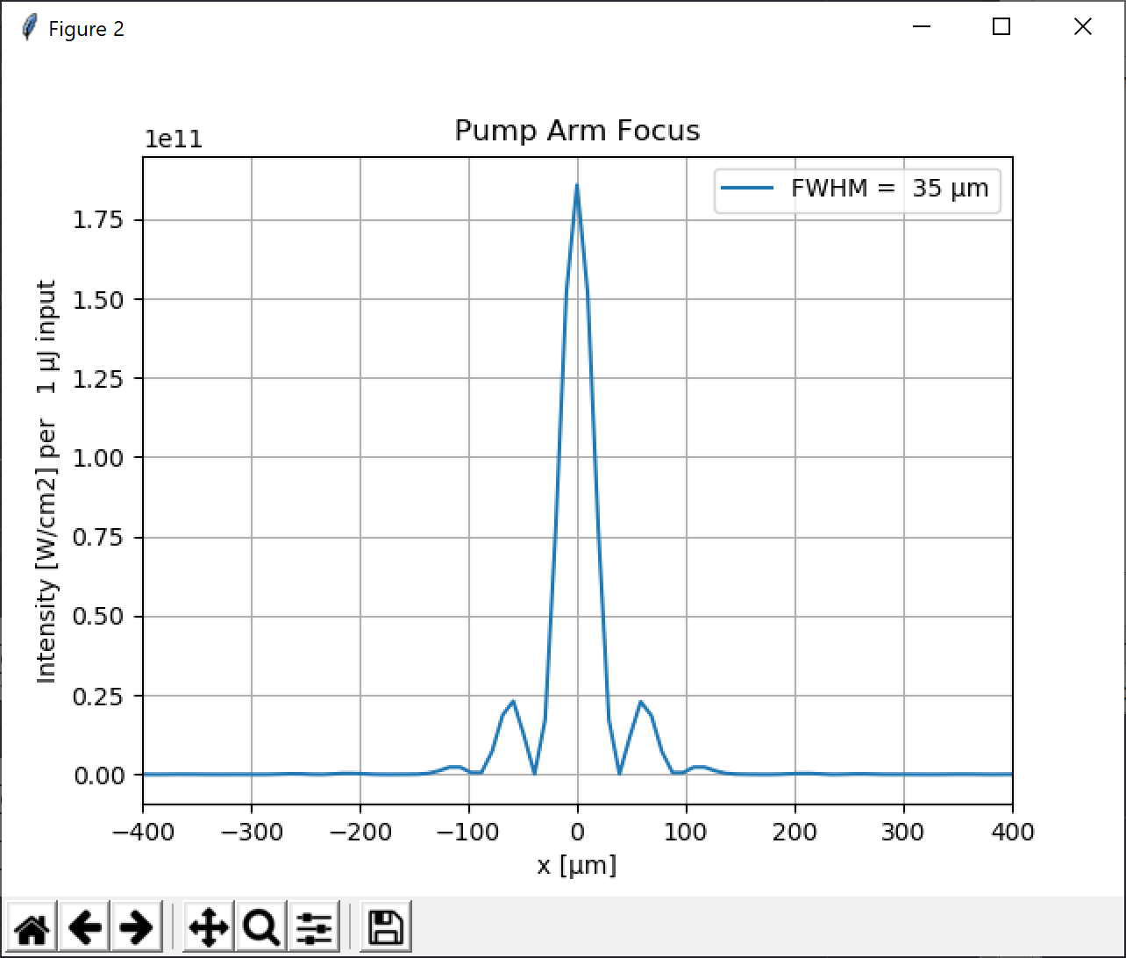
$$λ=1.5 μm$$
Notes:
20 mW = 20 mJ = 3.6 * 10^12 W/cm2
35 mJ = 6.3 * 10^12 W/cm2

